Slide 1
Asset Liability Management System
Team Members
Anjana J Nair
John Philip George
Nimish Shandilya
Sivadath K M
Sreni Saji
Date: 25th July 2025
Batch Details - Banking consulting batch 3

Slide 2


🔹
Contents
Problem Statement
Objective
Tools and technologies
High level architecture
Key Components
Step by step process
Code snippets and output
Challenges faced
Learnings and takeaways

Slide 3
🔹
Problem Statement
Asset liability management is the process of managing the use of assets and cash flows to reduce the firm’s risk of loss from not paying a liability on time
Well-managed assets and liabilities increase business profits.
Financial institutions must balance liquidity and minimize risk while complying with regulatory standards
Manual tracking of assets & liabilities is slow and error-prone
Absence of integrated systems can lead to financial mismatches and missed optimization opportunities

Slide 4
🔹
Objective
Deliver rich and interactive dashboard utilizing data visualization techniques for useful insights.
Help decision making through data-driven ad-hoc reports.
Achieve operational efficiency by eliminating redundant manual processes

Slide 5
🔹
Tools and Technologies
Backend: Spring Boot 3.5.3 & RESTful APIs
Frontend: OJET V 18, Knockout JS & Require JS
Database: MySQL 8
Data interchange: JSON
Build Tools: Maven 3
Testing: Postman,Swagger
Version: Git

Slide 6
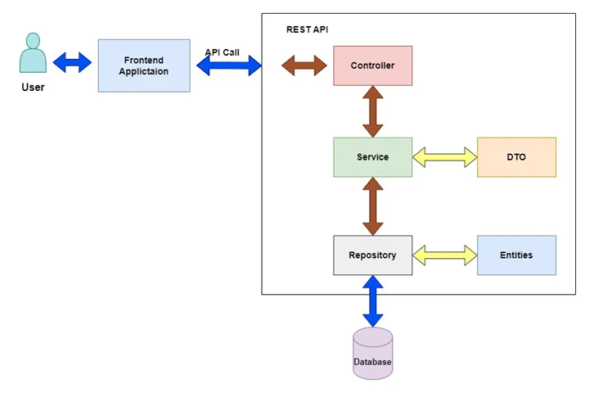
🔹
High Level Architecture
OJET

Slide 7
🔹
High level architecture
Spring boot consists of many layers/components, each of them handling a
different operation needed for the functioning of the backend. These are the
various layers of the Spring Boot architecture used in our case study
Controller: Used to make API calls to the frontend and backend
Service: Service contains the core business logic that is needed for the system
DTO: Transfer business data from service layer to UI layer.
Repository: Performs CRUD operations for business entitities.
Entities: Business entity classes having attributes mapped with business processes of the ALM system

Slide 8
🔹
End Points
Gap Analysis: Computes total rate sensitive assets and liabilities and returns the gap.
Gap = RSA - RSL
Net Interest Margin: Computes NIM for the given period.
NIM = (Interest Income - Interest Expense) / Average Earning Assets
Duration Gap Analysis: Calculates the duration gap on the given date.
Duration Gap = Duration of Assets - ( Duration of Liabilities * (Liabilities/Assets) )

Slide 9
🔹
End Points
Value at Risk (VaR): Computes portfolio VaR for the given date
VaR = Z × σ × √t × Portfolio Value
Liquidity Gap Analysis: Returns liquidity gap for a specific time bucket as well as for all time buckets.
Liquidity Gap = Maturing Assets − Maturing Liabilities
Asset Coverage Ratio: Calculates asset coverage ratio for a date.
Asset Coverage Ratio = ((BVTA − IA) − (CL − STDO)) / Total Debt

Slide 10
🔹
Key Components
Portfolio dashboard summarizing key ALM metrics like liquidity gaps,
net interest margin, rate sensitive asset, asset-liability mismatches
Drill down views
Asset & liability breakdowns by product type
eg: loans, securities, deposits
Filtering by maturity, currency buckets and counterparty
Backend architecture and infrastructure
Eureka server
Actuator
Aspect Oriented Programming
Frontend UI
Rich graphical UI for dashboard and analysis
Microservices architecture
Modular services for API management, business logic and data persistence
Decoupled service endpoints for scalability

Slide 11
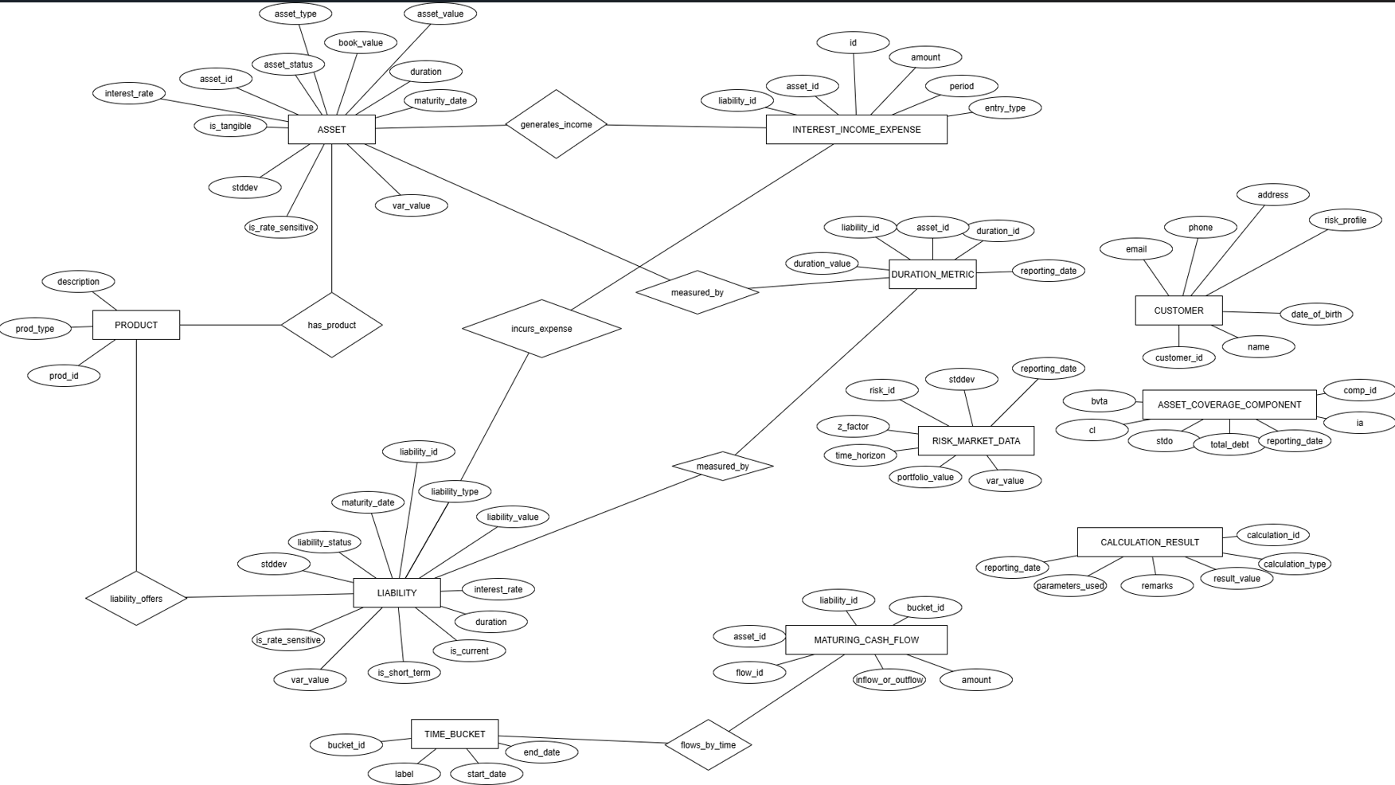
E-R Diagram
🔹

Slide 12
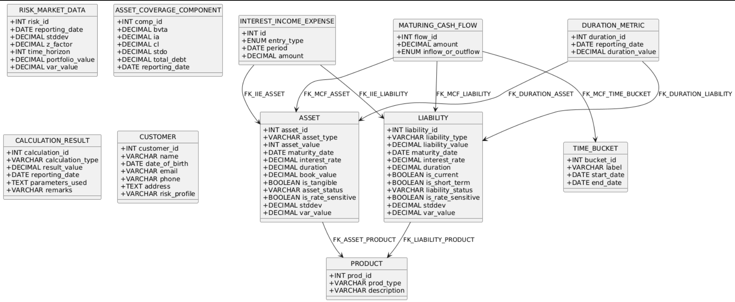
Class Diagram
🔹

Slide 13
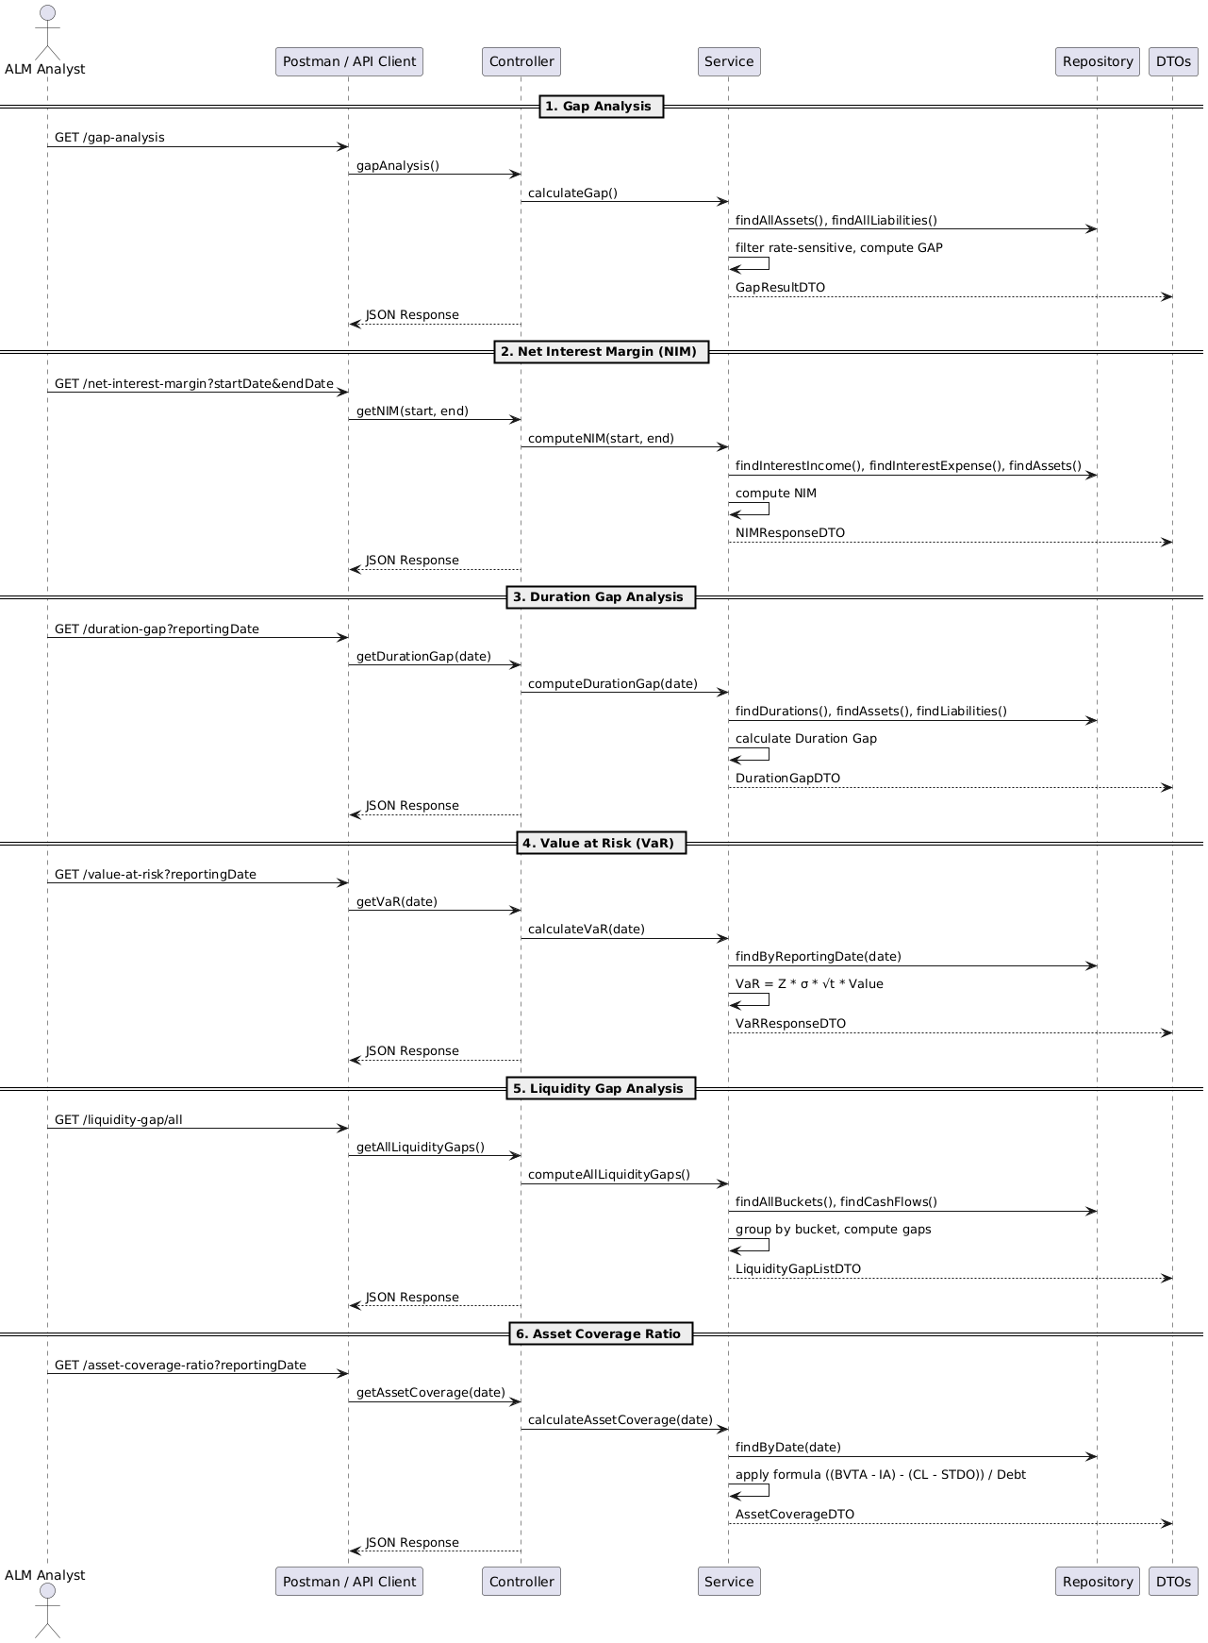
🔹
Sequence Diagram

Slide 14
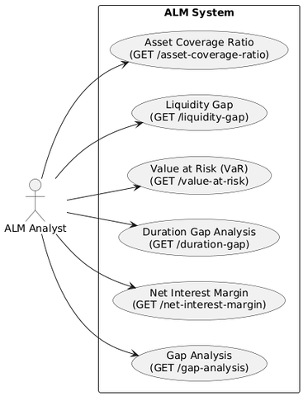
Use Case Diagram
🔹

Slide 15
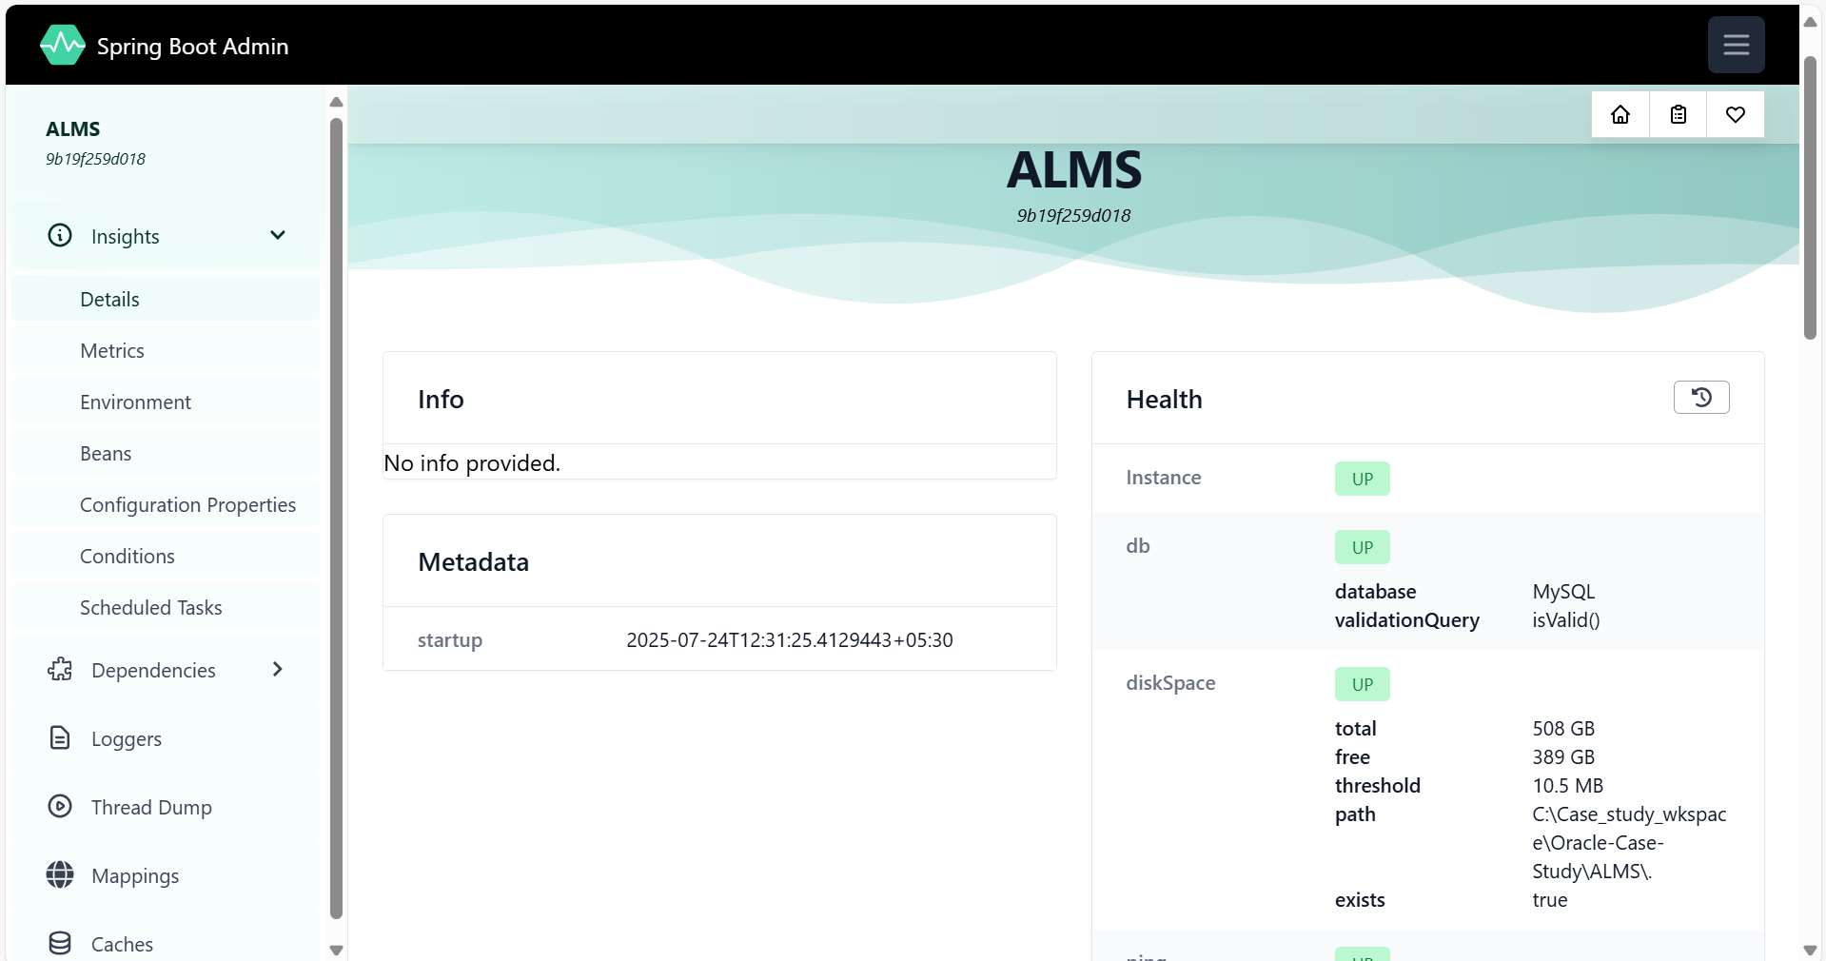
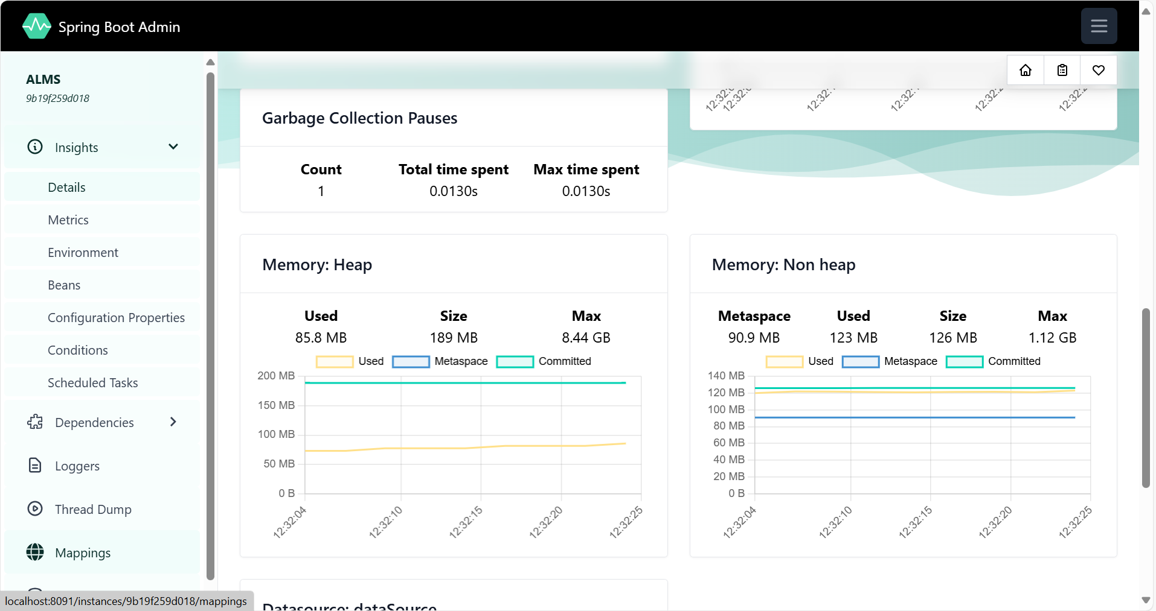
🔹
Microservice operational metrics gathering using Spring Boot actuator and analysis using code-centric Admin Server

Slide 16
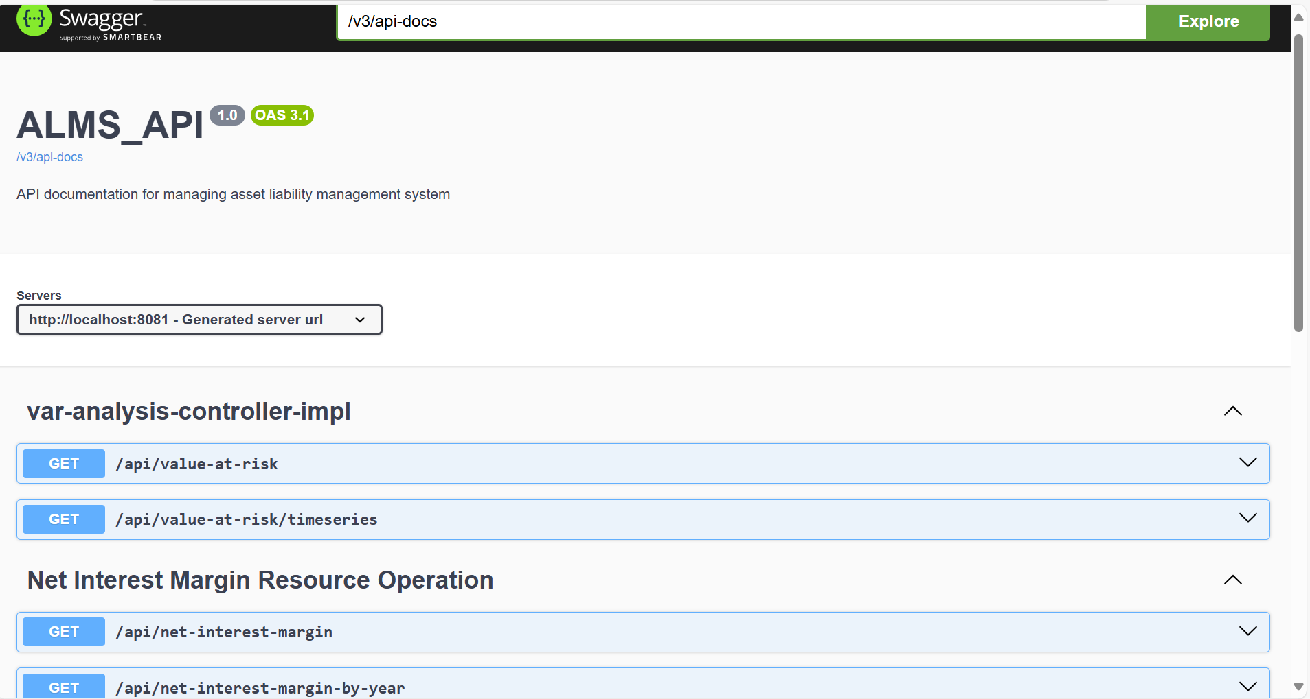
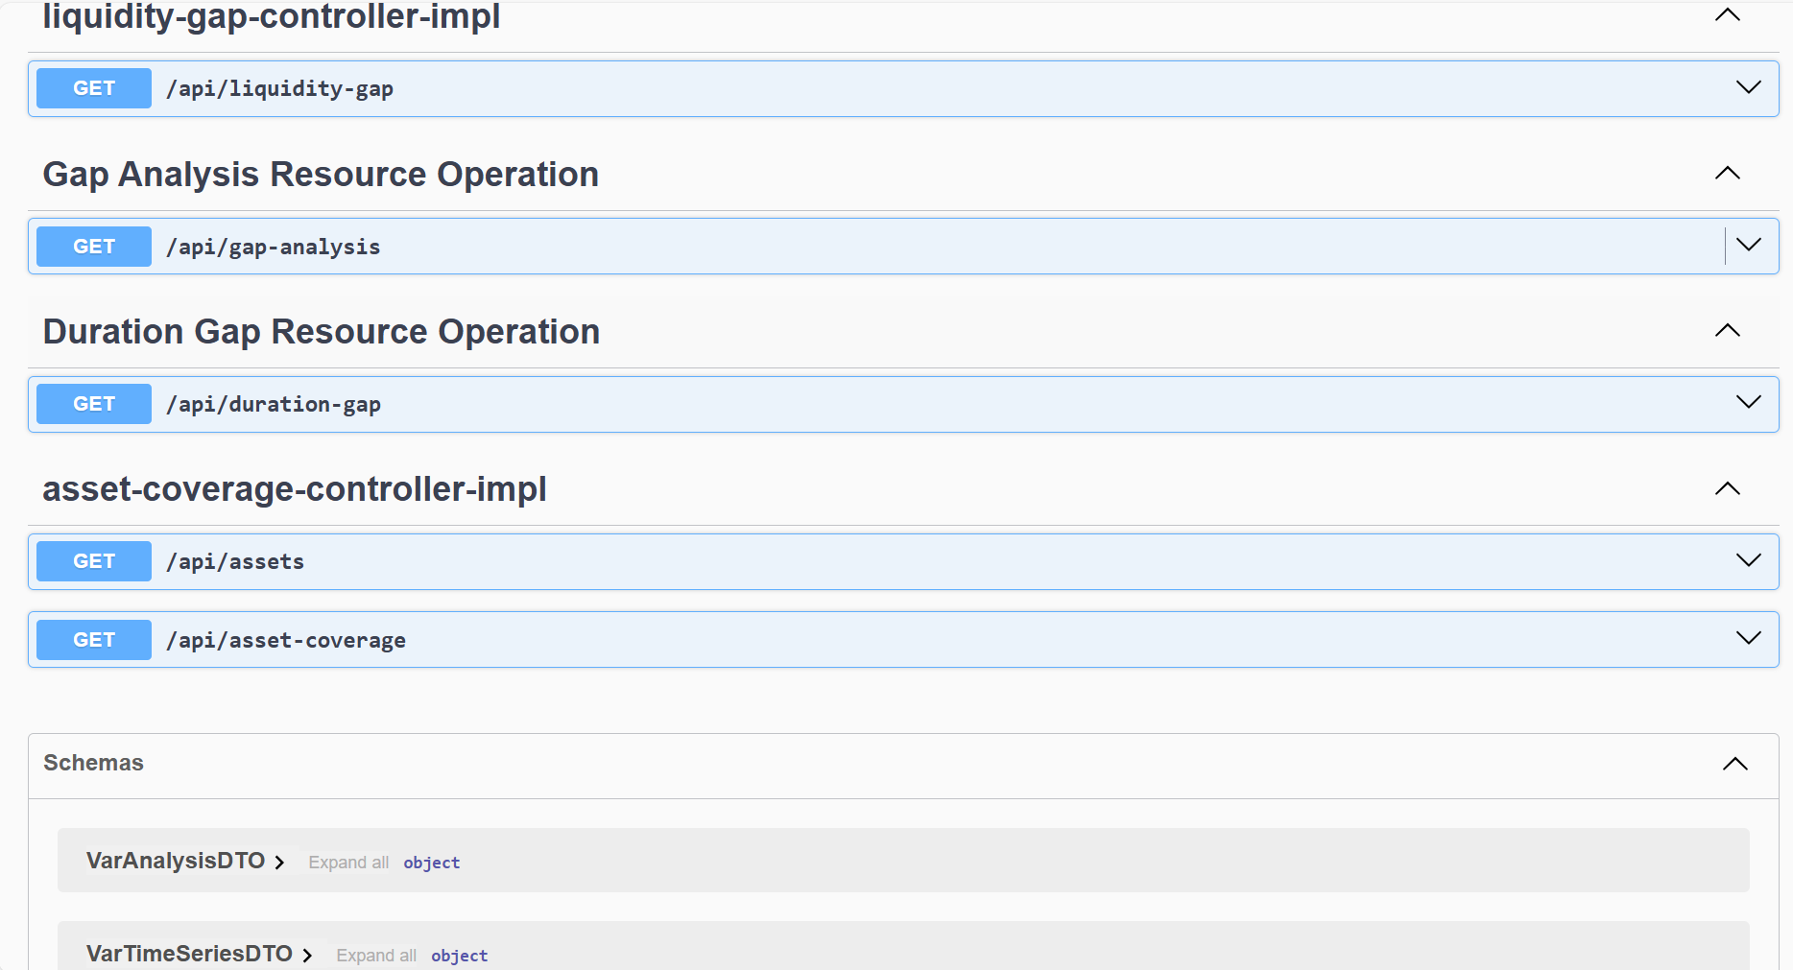
🔹
Open API Specification documentation for Rest Endpoints using Swagger

Slide 17
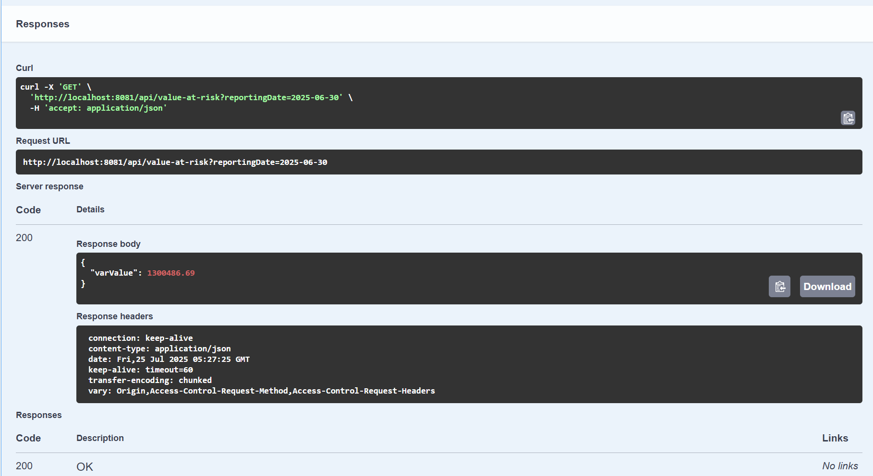
🔹
Testing of Endpoint

Slide 18
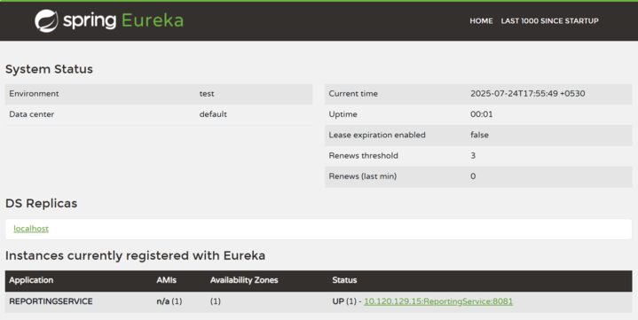
Service Discovery Using Eureka Server
🔹

Slide 19
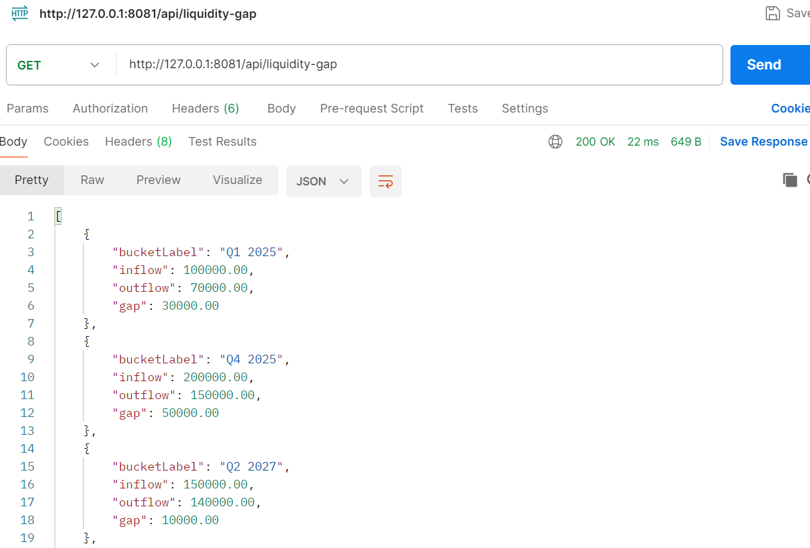
🔹
POSTMAN
For testing API endpoints

Slide 20
🔹
Static Code Analysis Tools
These are the static code analysis tools that we used. Plugins for
these tools were mentioned in the pom.xml file and different goals
were given for each tool
PMD: Checks for any unused imported packages and methods
Checkstyle: Checks if the entire codebase is following std naming conventions and styles
Spotbugs: Spots any bugs that occurred during development

Slide 21
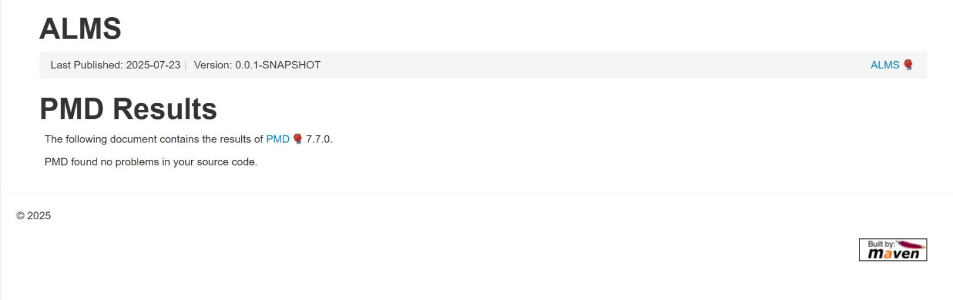
🔹
PMD

Slide 22
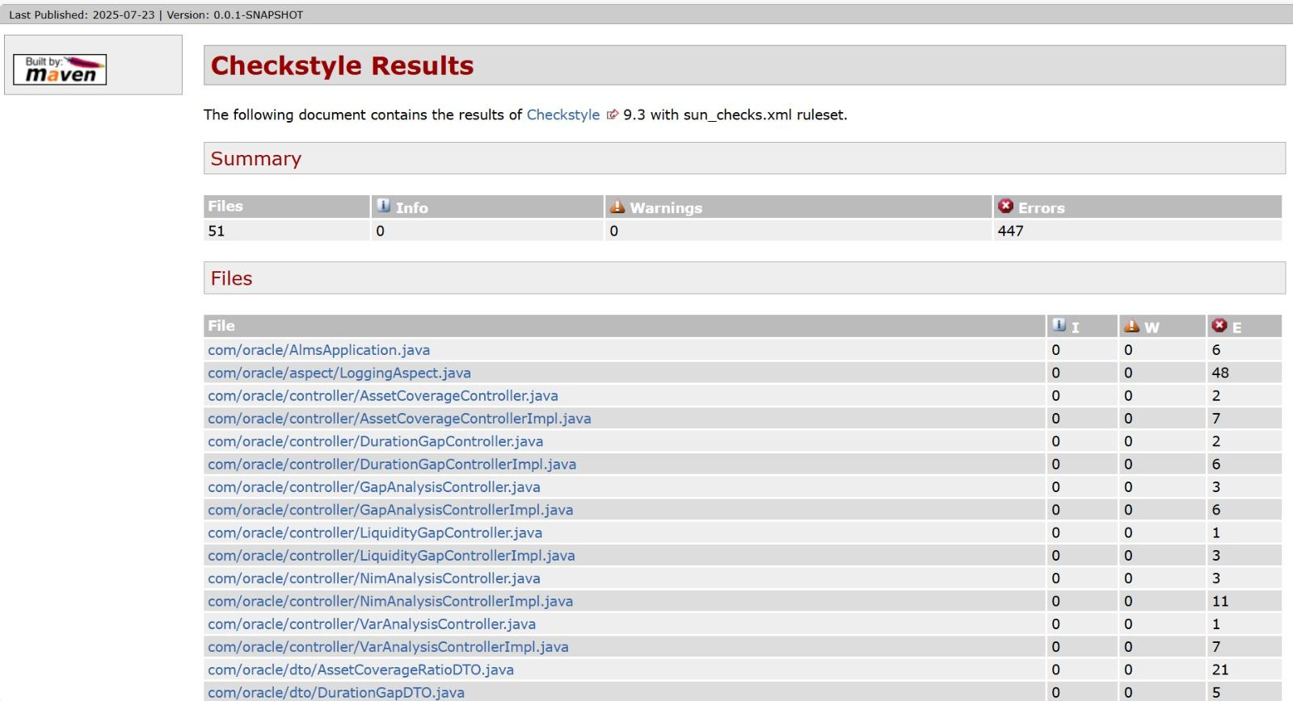
🔹
Checkstyle

Slide 23
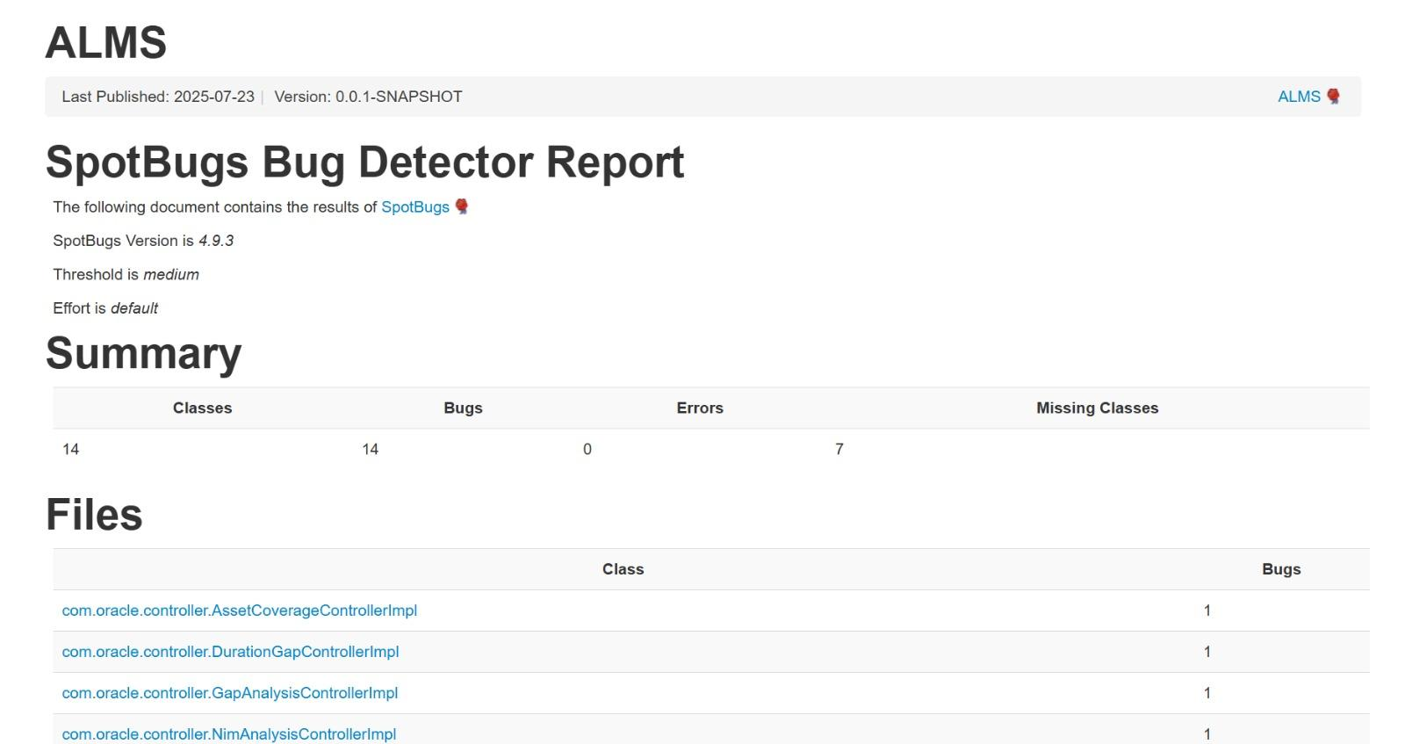
🔹
Spotbugs

Slide 24
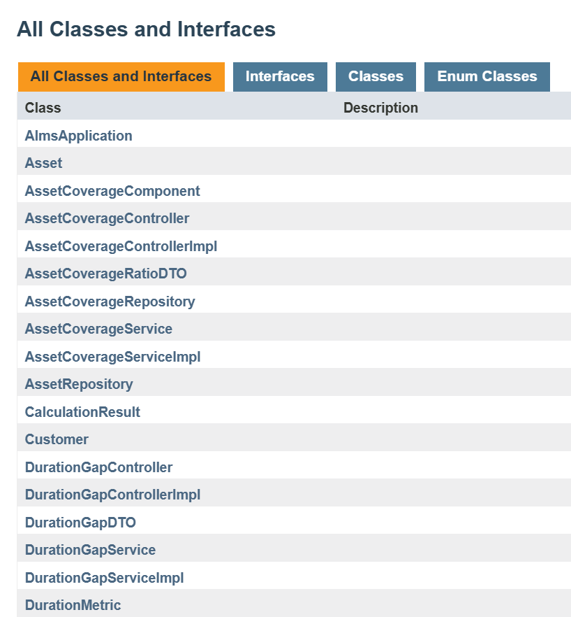
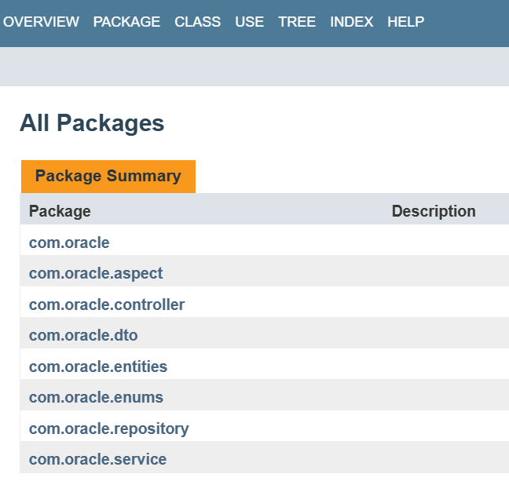
🔹
Javadoc

Slide 25
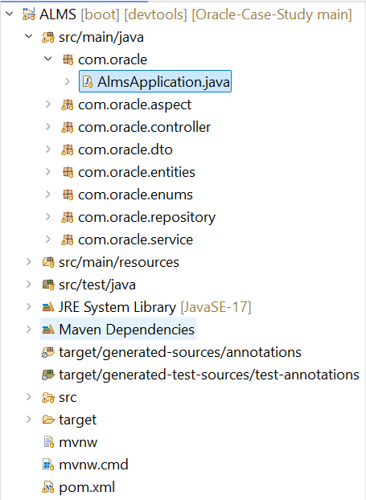
🔹
Project Structure(backend)

Slide 26
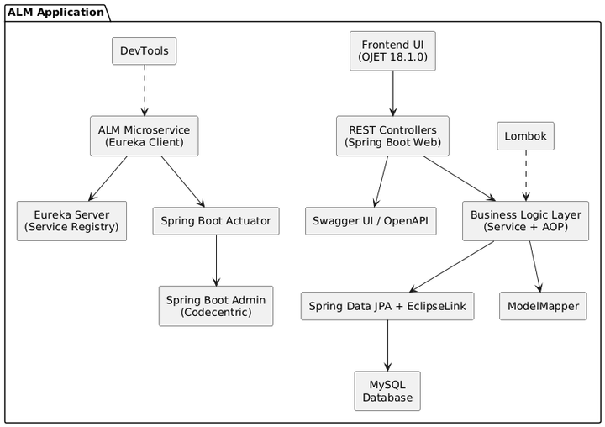
🔹
Project Dependency Structure

Slide 27
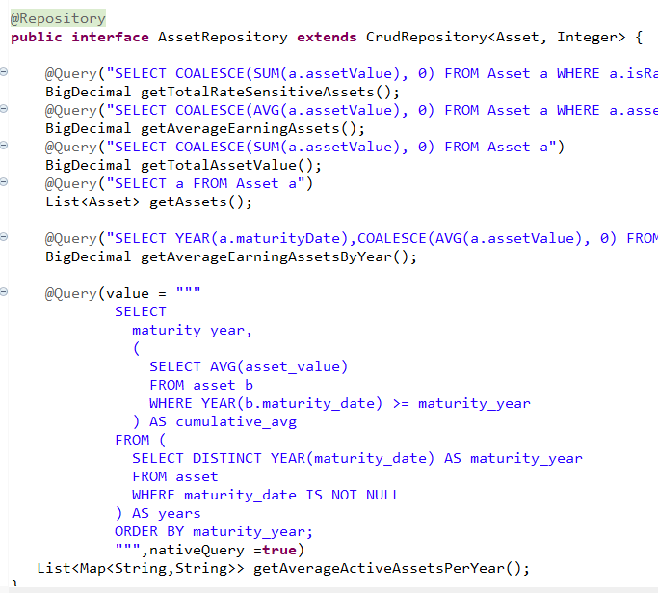
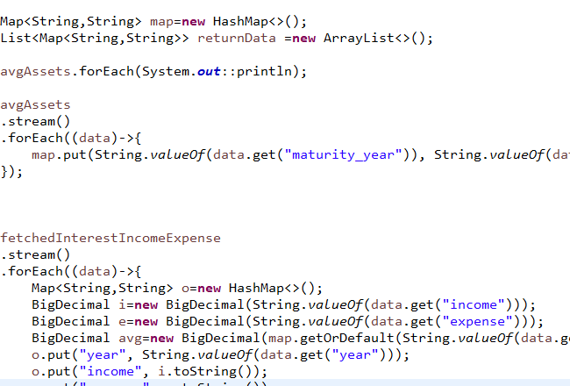
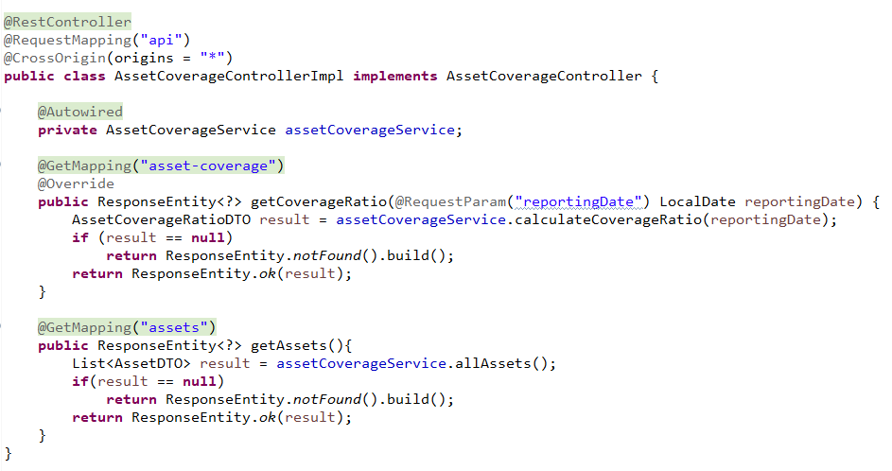
🔹
Code Snippets (Backend)
Native and JPA Queries
Computations using Stream API
Restful Controller End-point

Slide 28
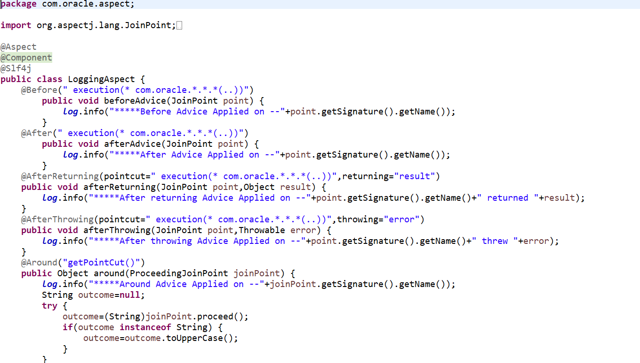
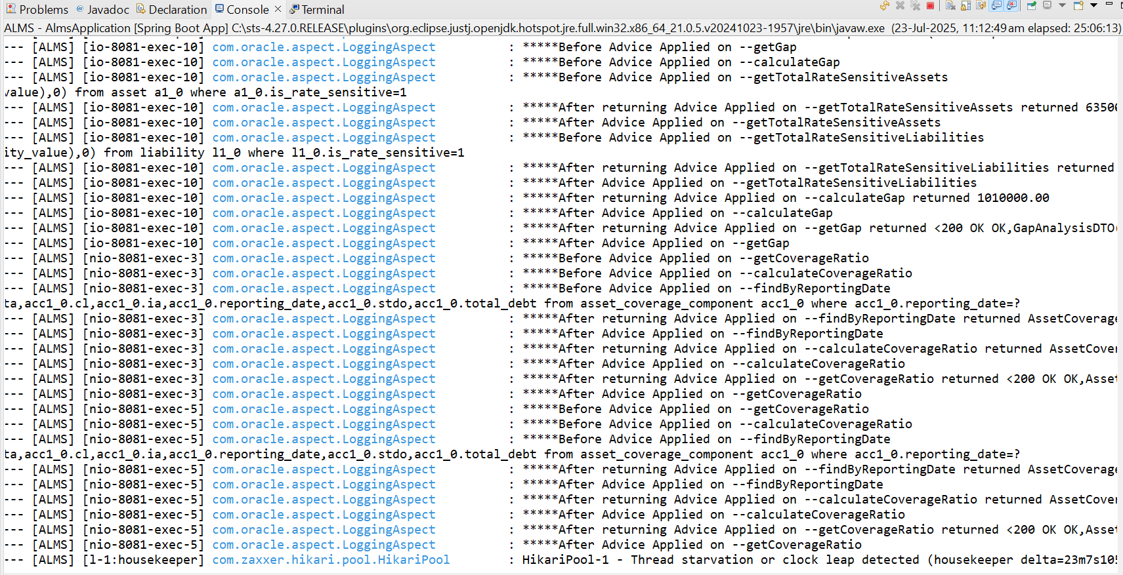
🔹
Separation & Modularization of cross-cutting concerns utilizing Spring AOP module

Slide 29
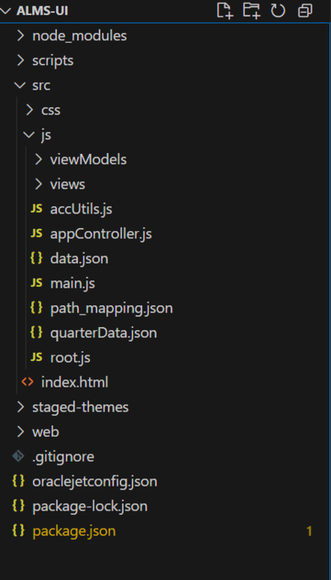
🔹
Front End Project structure

Slide 30
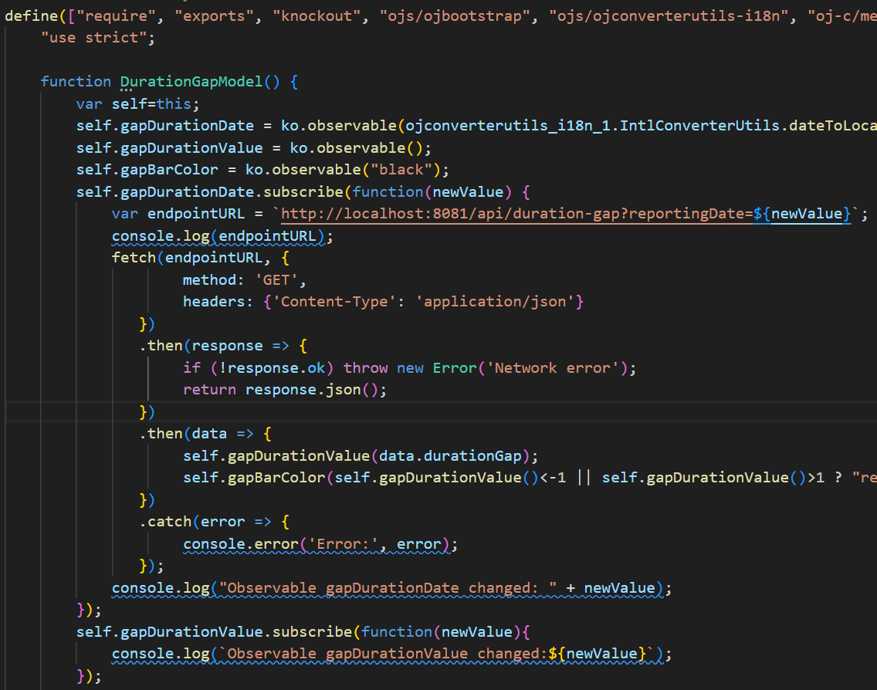
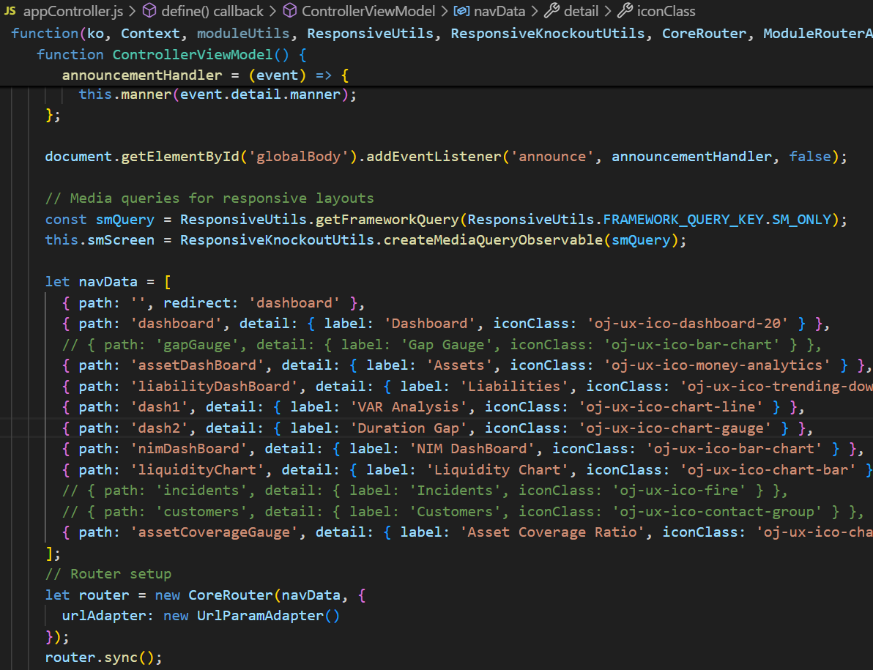
🔹
Code Snippets (Frontend)
Rest-API Call
Routing and Navigation

Slide 31
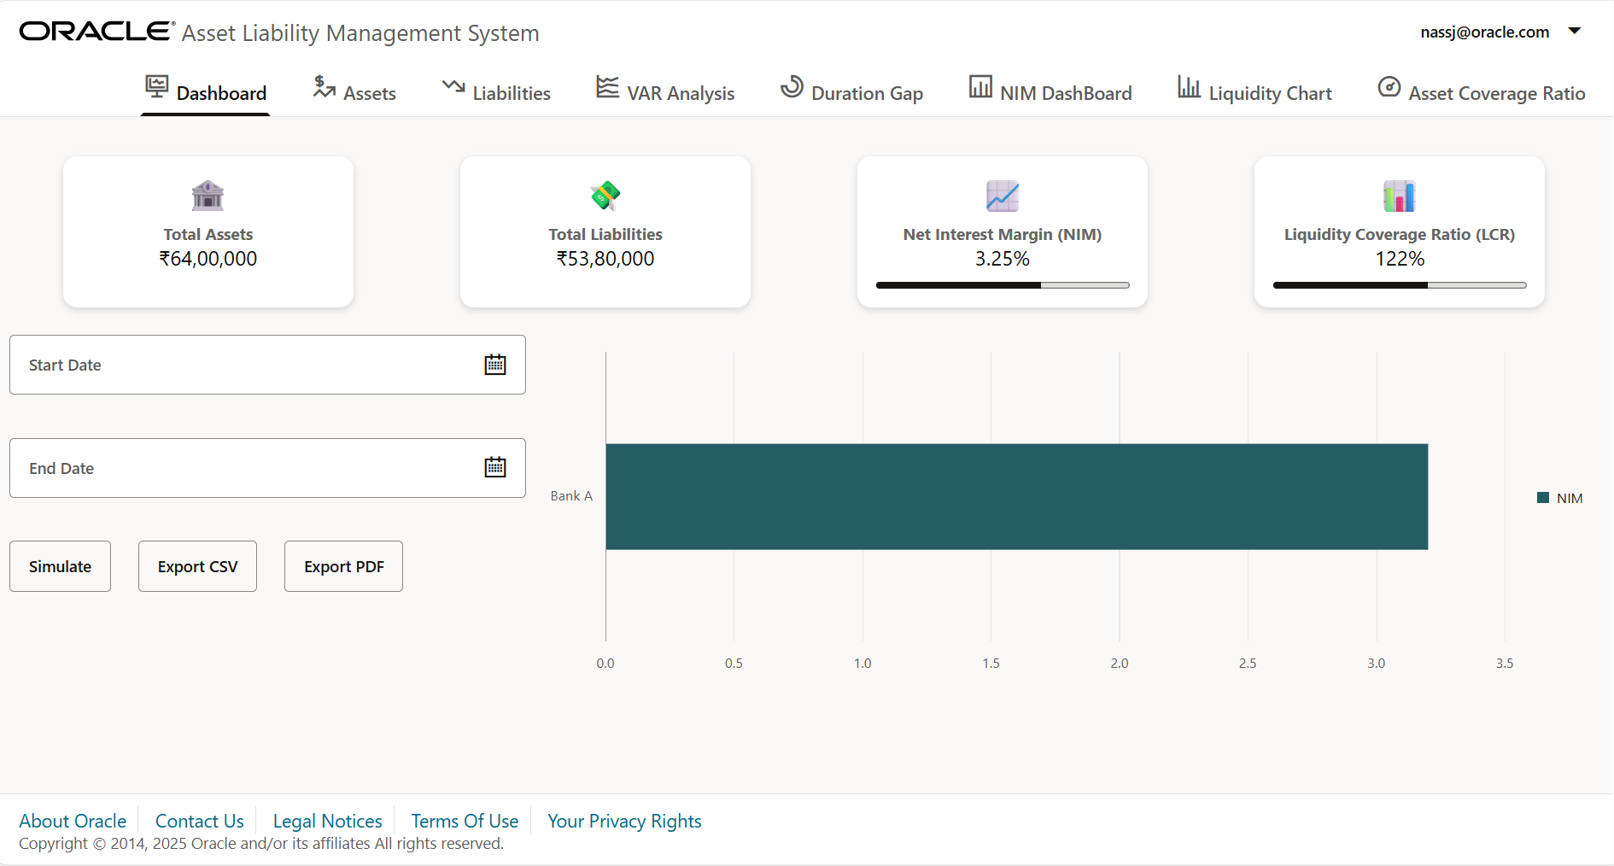
🔹
Dashboard

Slide 32
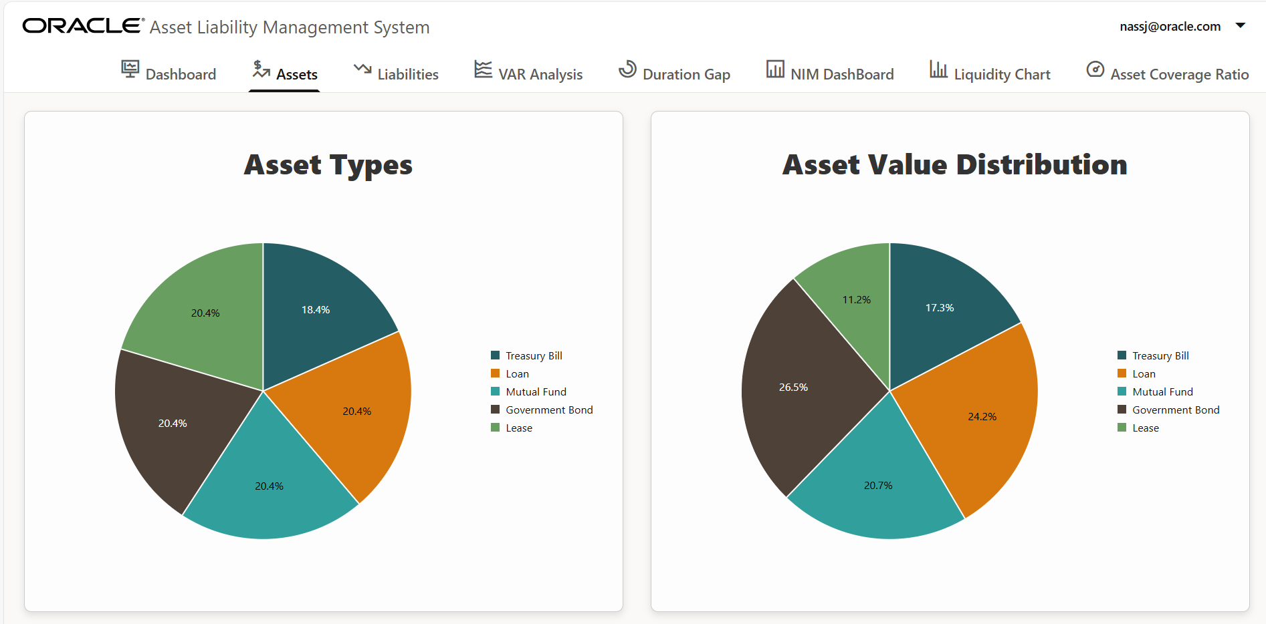
🔹

Slide 33
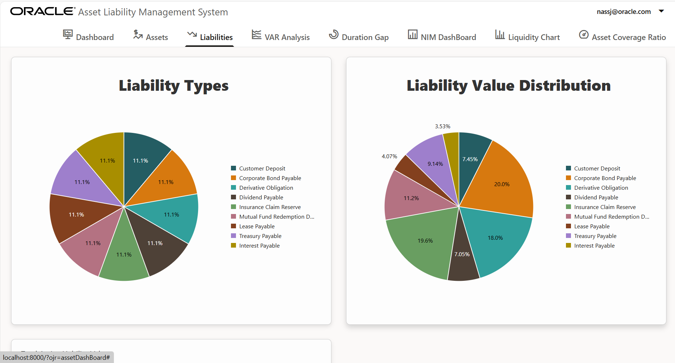
🔹

Slide 34
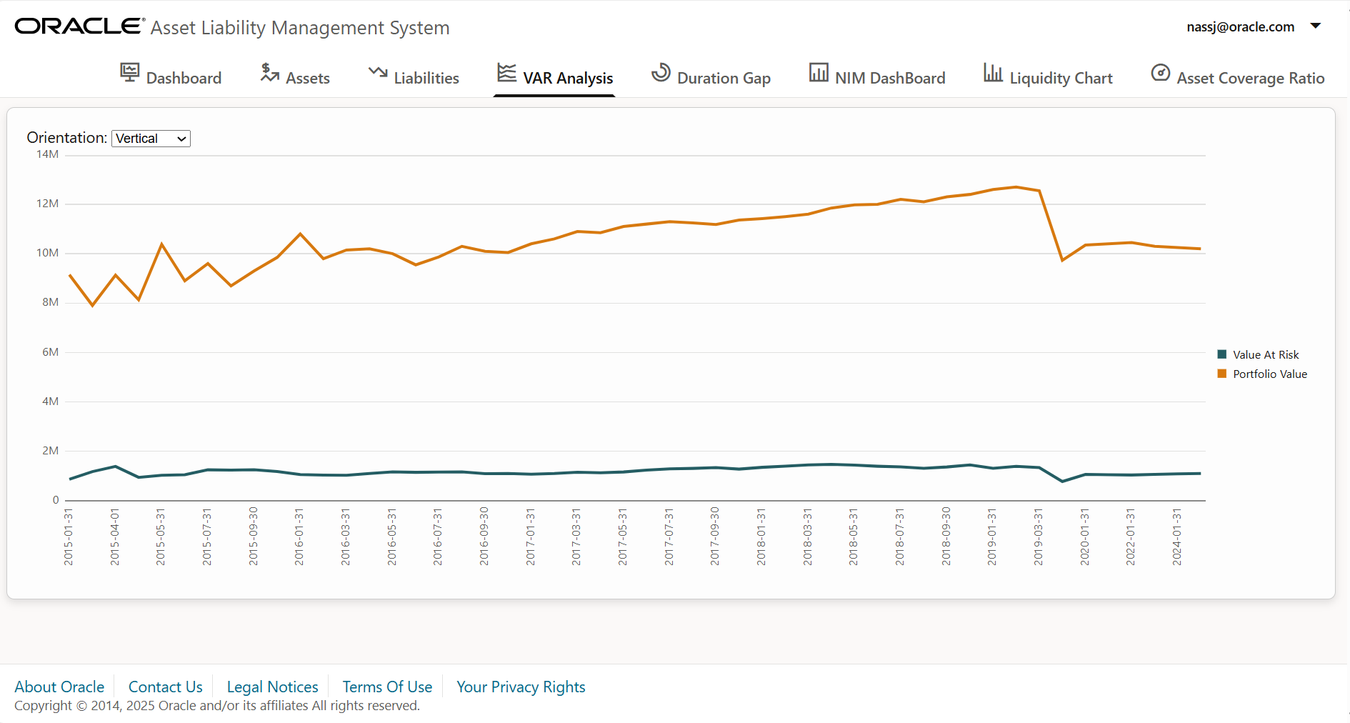
🔹

Slide 35
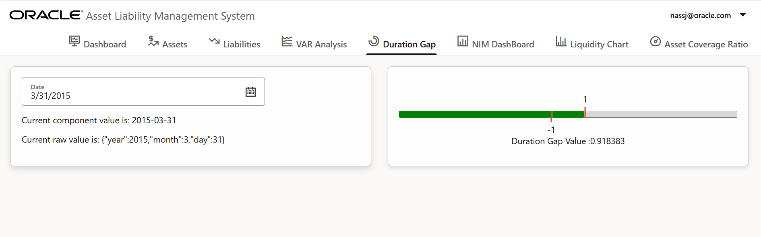
🔹

Slide 36
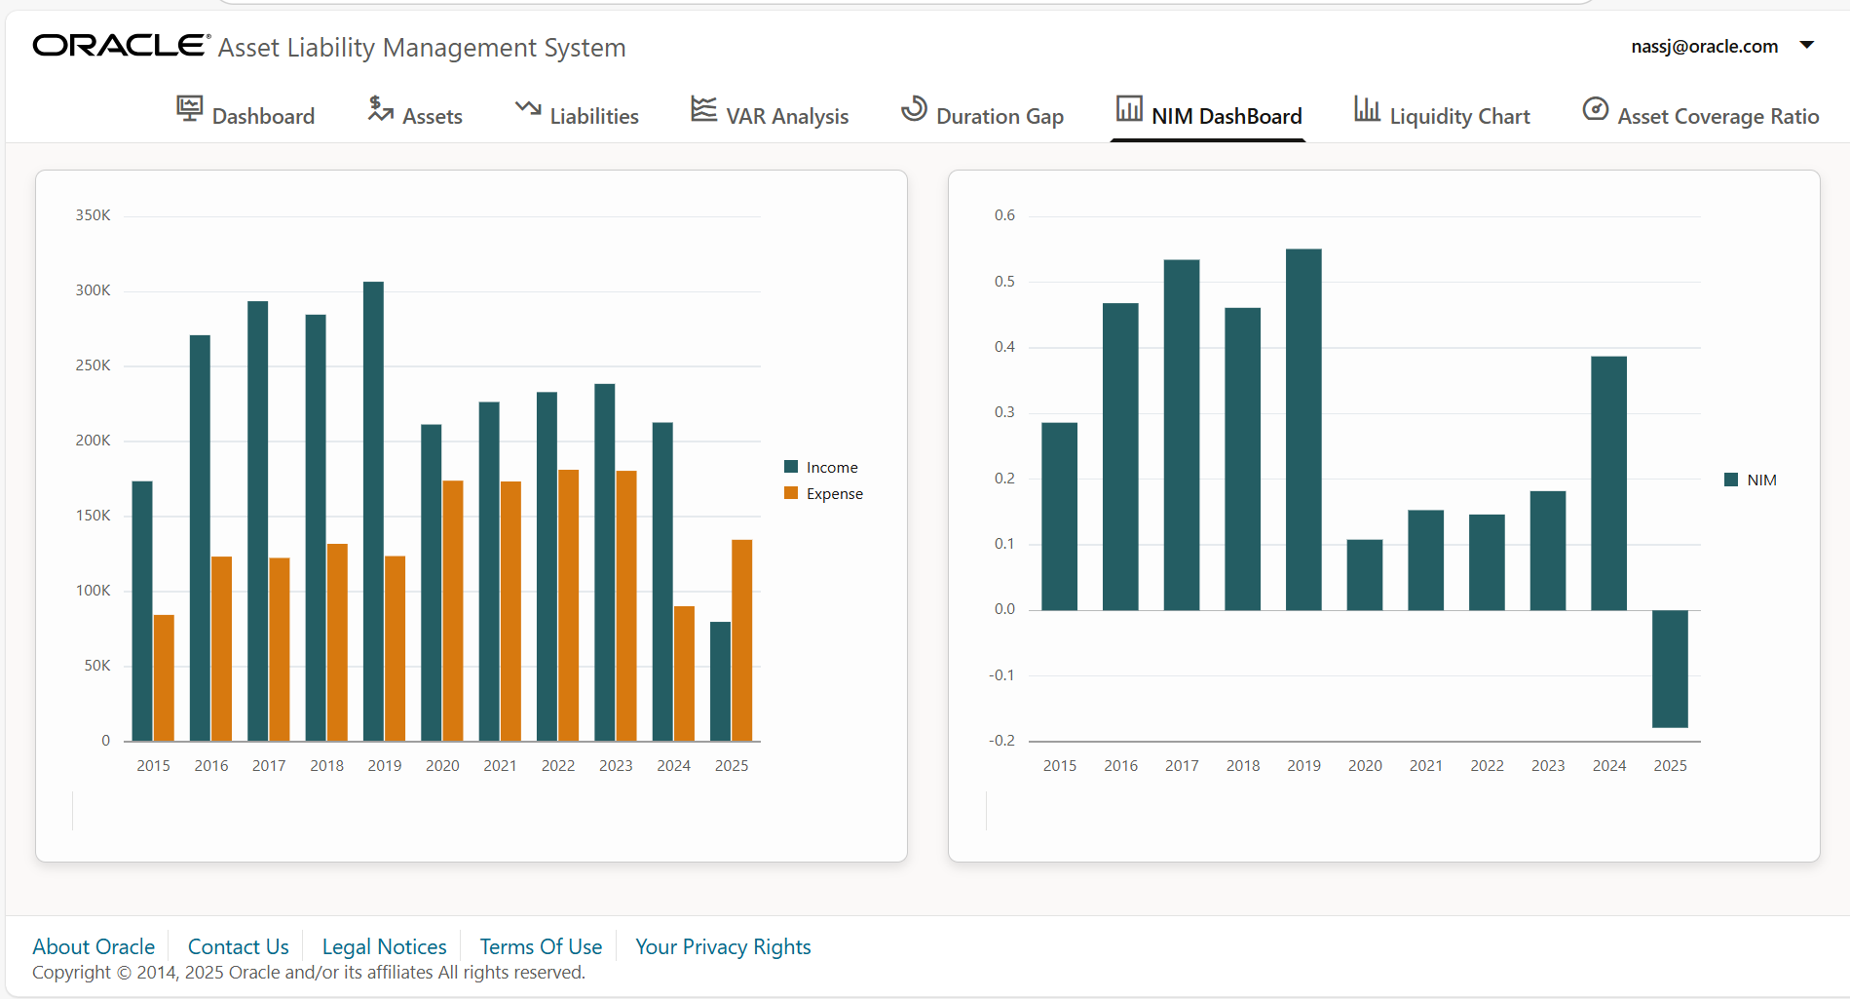
🔹

Slide 37
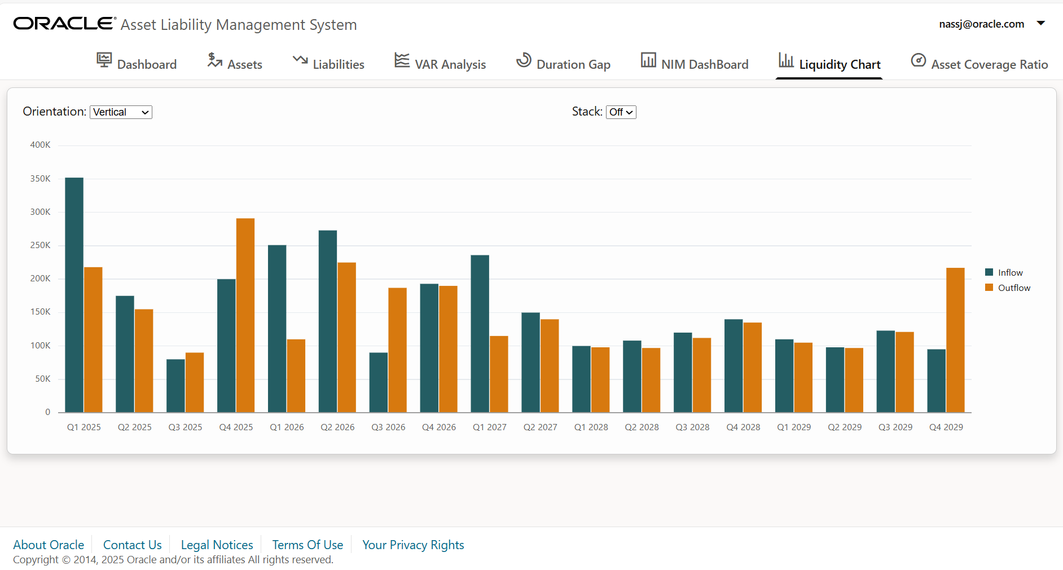
🔹

Slide 38
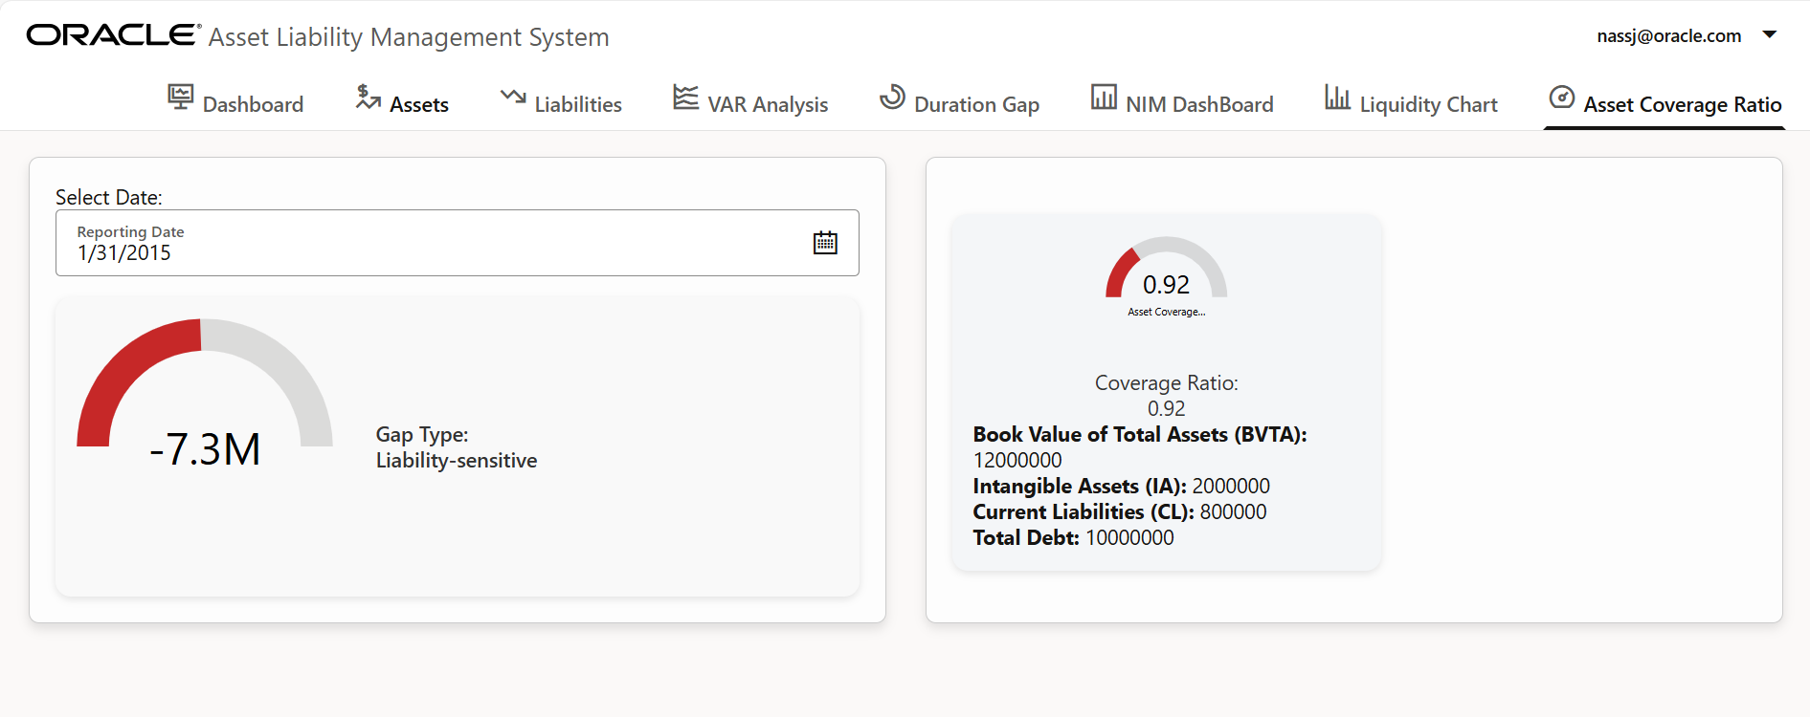
🔹

Slide 39
🔹
Step-by-step process
Identify entities and attributes according to functional requirements of ALM system
Created database schema and populating sample data in MySQL
Set up project skeleton using Spring Tool Suite and Maven
Perform entities mapping from business application to database
Developed REST controllers, services and repositories in Spring Boot
Create REST APIs and test them on Postman
Create frontend application using OJET v 18
Make API calls to fetch and push data
Data Visualization

Slide 40
🔹
Challenges faced
Domain complexity and learning curve
Understanding ALM concepts: Asset Liability Management involves financial, statistical and regulatory concepts
Translating finance logic into programs: Mapping financial logic to technical implementation
Understanding OJET components ,routing and charting
Entity mapping and creating a RESTful architecture
Database design as per normalization rules.

Slide 41
🔹
Learnings and takeaways
Documentation, logging and code quality
Implementation of Aspect Oriented Programming to capture invocations, exceptions and performance metrics
Application of static code analysis tools to adhere to industry standards and to maintain code quality
Utilizing OJET cookbook to integrate various UI components like charts(bar, pie) and gauges using Oracle JET 18.1.0
Various financial instruments used in asset liability management
Extensively tested APIs using Postman collections and scenario-based test cases
Centralized service visibility through Codecentric Admin Dashboard, including uptime, memory usage, and service registration.

Slide 42
🔹
Thank You….!

